Slide 1
Secure Web Programming
Lecture 12 MVC on the web
Amanda.Lunt@utas.edu.au
Soonja.Yeom@utas.edu.au

Slide 2
Topics
Secure Web Programming
Week13
Review
Basic Web Programming
Web Security
Adv. Web Programming
Fundamentals – protocol, CS model, etc.
HTTP Protocols, Storage
Advanced Web Applications
Human Computer Interaction with Web Page Design
Security Issues and Technologies
Session management
Client-side Scripting Language and Document Object Model
Secure Programming and Users
Common Gateway Interface
Server-side Scripting Language and Privilege configuration
Encryption and Authentication
Advanced Security Issues

Slide 3




Review: CGI Lifecycle (with Perl or C)
Client Computer (Browser)
Web Server
CGI
Web server send the request message to the CGI program in environment variables
the web server can send data to the child CGI process via the child's STDIN
the web server reads data that the child sends to its STDOUT, and passes this back to the web client
Database
CGI Program

Slide 4

Review: PHP LifeCycle
Web Server
Client Computer (Browser)
Database
PHP Interpreter
Client-side
Server-side

Slide 5
Review: PHP, JSP, and ASP
 | PHP | JSP | ASP
Operating System (OS) | Linux (Unix) Windows | Linux (Unix) Windows | Windows
Web Service Demon | Apache, IIS (Internet Information Server) | Apache*, IIS | IIS, PWS (Personal Web Server)
Script Interpreter | PHP | Tomcat, Resin, Jrun, Weblogic, GNU JSP, WebSphere, OSDK, JServ | IIS PWS (Personal Web Server)
Database | Oracle, MySQL, MS SQL, Access, etc. | Oracle, MySQL, MSSQL, Access, etc. | MS SQL, Oracle, Access, etc.

Slide 6
Our experiences
We built out web pages like this:
Merging PHP and HTML code in one php file
Used db_conn.php for database connection
Used external css for seperating appearance
Data, Logic, and Presentation are All-in-one code
Good for Event-based Task Development

Slide 7
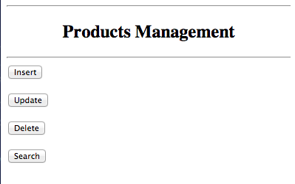
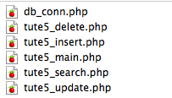
Output of Tutorial 5 main page
Files for Tutorial 5

Slide 8
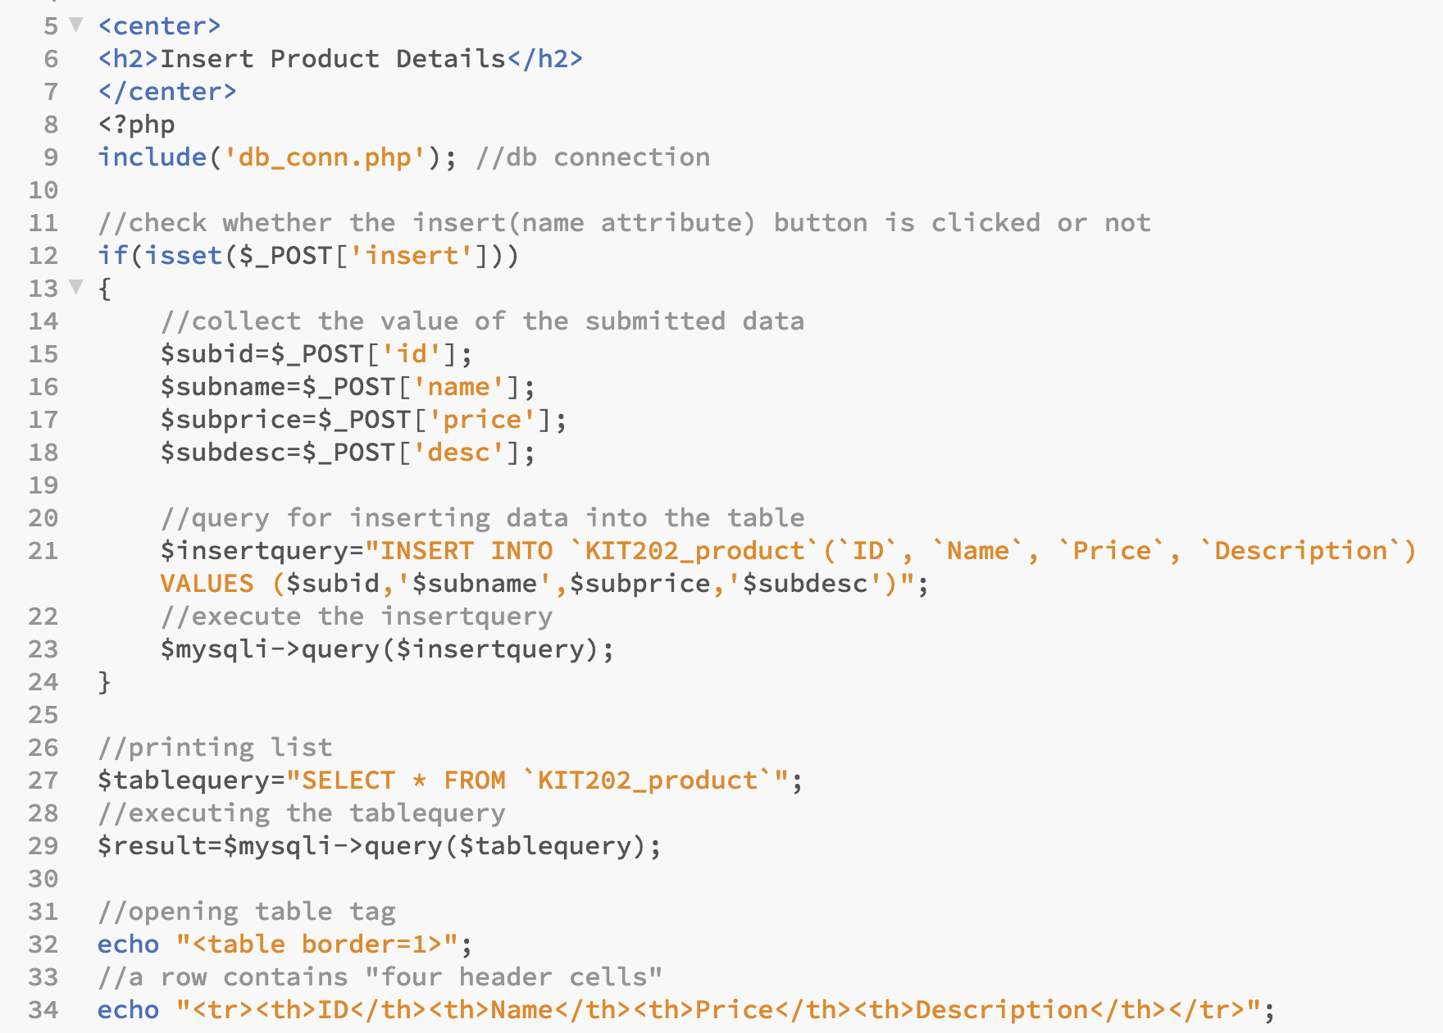

Slide 9
Issues with using all-in-one code
Combining Logic part and Presentation part
As the logic part (php code) and presentation part (incl. html code in echo) are combined in the one file, it is necessary to discuss with web designer whenever you need to modify
Difficult to work as a team (developers)
It is very difficult to separate the work as modules
Difficult to manage
If the application/page is getting complicated, it is almost impossible to separate different logic module.
Difficult to reuse
It requires a lot of modifications
How to solve this issues?

Slide 10
Organising code
Data encapsulation
Keep data in an object that acts as an intermediary between the program and the underlying data store
Knows how to load and save the data inside of it
Pluggable/interchangeable user interfaces
Program decides which UI to display based on some logic.
Pieces of data injected into UI as appropriate.
Simple, concise control flow logic.
Decide which UI to display, data to update, etc.

Slide 11
What is MVC?
Model-View-Controller Pattern
Provides clean separation of logic, data, and presentation (UI)
Allows each to work independently and interchangeably
Allows to decide which UI to output based on form validation
Allows same data (Model) to display on multiple UIs

Slide 12
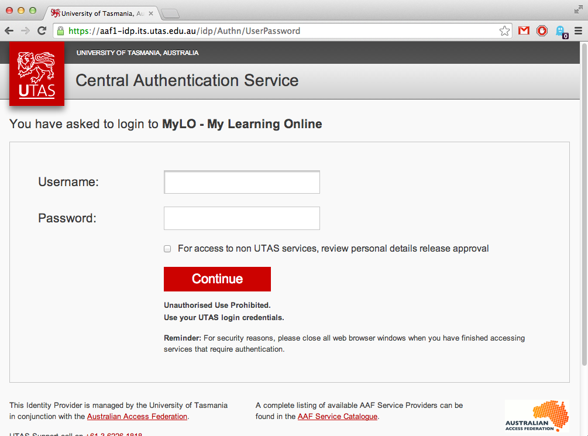
Model-View-Controller Pattern
Browser
Model
Controller
View
Database

Slide 13
MVC (1) - Model
Model
Model represents the Data
Data structures that store the information
Often interfaces with the underlying data store
Files
Database
Takes care of fetching, adding, updating data in the underlying store
Database

Slide 14
MVC (2) - View
View: User Interface
Presenting the pieces of data plugged in
Providing event handlers to respond to user input.
The “front end” of the program
Displaying the information, but not directly extracting it from storage or processing users’ input
Expects to be provided with the data it outputs
View

Slide 15
MVC (3) - Controller
What is Controller?
Deal with business logic
Interact with Model and View layer
processes data, and decides what UI should be presented to the user.
input-based management :
Validates data submitted from a View layer
invokes the appropriate Model to load the data
Output-based management:
Sends updated data to the appropriate Model to store
Decides which page the View layer to display next
Sends the appropriate data to the View layer
Controller

Slide 16
Model-View-Controller Pattern
Browser
Model
Controller
View
Database

Slide 17



PHP MVC frameworks
CakePHP : http://cakephp.org/
Symfony : http://symfony.com/
Zendframework : http://framework.zend.com/

Slide 18
MVC and others
MVC
MVP
MVVM
Browser
Browser
Browser
M
C
V
M
P
V
M
Vm
Vi
M : Model V : View
C : Controller
M : Model V : View
P : Presenter
M : Model Vi : View
Vm: View Model

Slide 19
Controller, Presenter, and View model
MVC
Controller: All input data is managed by controller. It sends input data to Model layer, and receive the output data from Model data. Based on that, it choose different View.
MVP
Presenter: It interacts with both View and Model layer (like a Bridge). As the input data is managed by View layer, what Presenter does is only sending, receiving, and interacting with View and Model
MVVM
View model: View model is an abstraction of the view that also serves in mediating between the view and the model which is the target of the view data bindings

Slide 20
Use MVC in PHP
There are two main approaches:
Template style – Smarty
Mixed imperative and class/object style
PHP framework – Cake framework
Class/Object style throughout

Slide 21
MVC in PHP – with Smarty (Template)
Browser
Model
Controller
View
Class style
Imperative style
HTML templates

Slide 22
MVC in PHP – with Smarty (Template)
Browser
Model
Controller
View
PHP Classes SQL
NO HTML
Smarty Controller
Smarty templates
(HTML and Smarty variables) No SQL

Slide 23
MVC in PHP – with Smarty (Template)
Browser
Model
Controller
View
Construct model classes for the application
Create controllers that pass data to views
Construct Views HTML templates

Slide 24
MVC in PHP – with Smarty (Template)
Have a look at the template.
Model
Controller
View
Any PHP classes Database
mainpage.php
mainpage.tpl

Slide 25
MVC in PHP – Login Form
MVC-based Login Form in PHP
Model: Manage the data
Retrieving the user’s data from the database
Validating the user’s username and password
View: Represent the page
Presenting login page (incl. login form)
Presenting after login page (incl. Welcome or error message)
Controller: Interact with Model and View layer
Pass the data to views

Slide 26
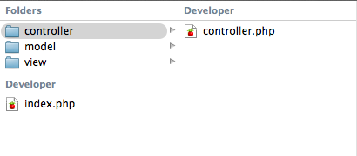
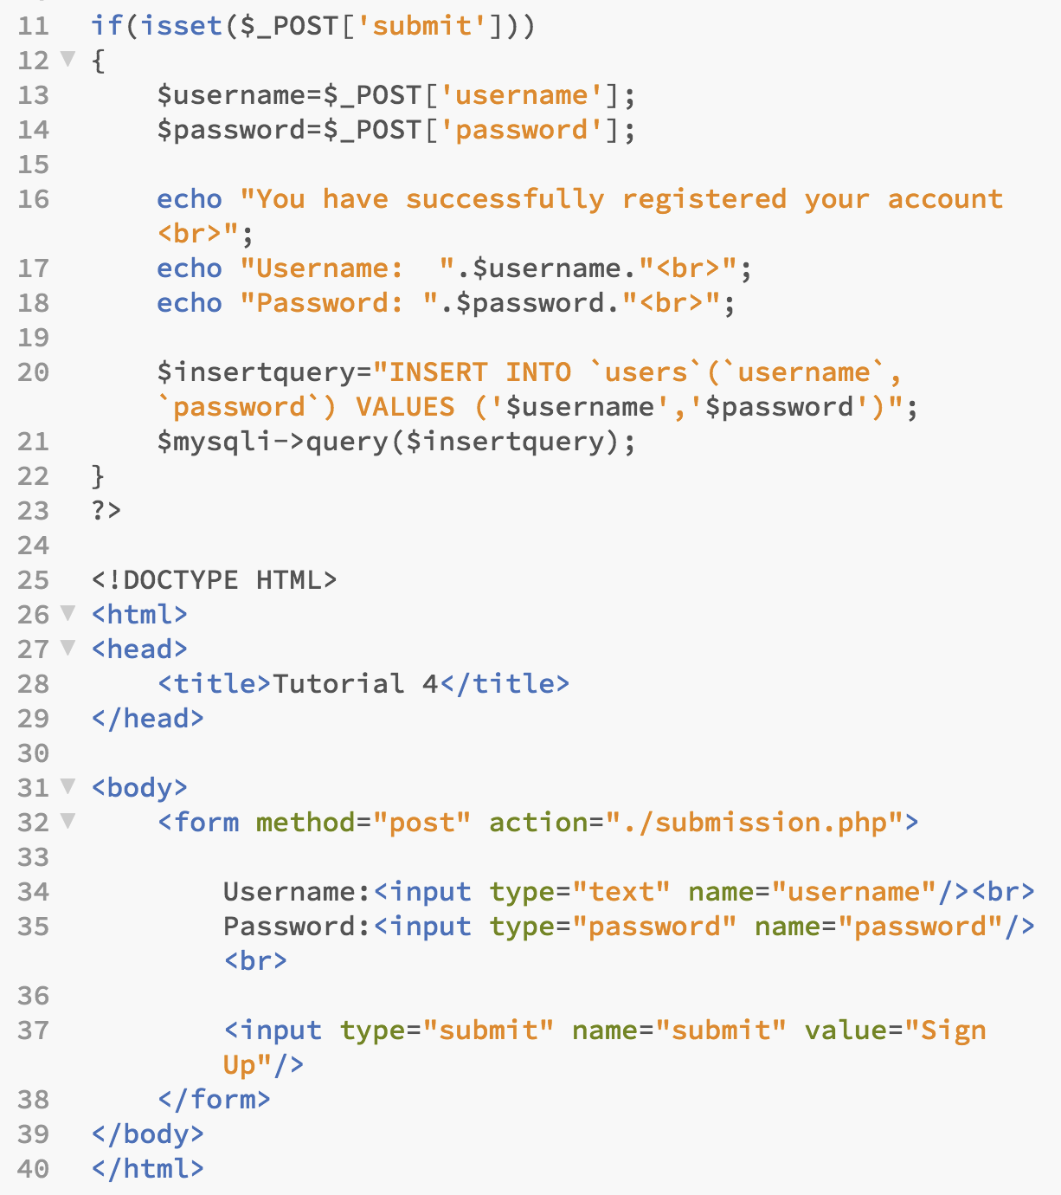
MVC in PHP – Login Form
One PHP FILE
MVC-based

Slide 27

The output and your choice..
Using one php file or MVC-based system, the output is same
You should choose MVC-based if:
you work as a team
you need to separate presentation and logic part
you care about the maintenance
you need test driven development
One PHP FILE
MVC-based

Slide 28
MVC on Web Designer’s view
Browser
Model
Controller
View
Crazy database stuff.
I leave to programmers
The “Project Manager” who dumbs down the technical stuff into simple works
My world, keep out!

Slide 29
Source Management
How we manage our code?
Version control? Version control allow to keep all the historical versions of your software for easy tracking
How do I control the version effectively?

Slide 30
Source Management: SVN and GIT
SVN
GIT
Repository
In the server
Remote Repository
In the server
My computer
My computer
Local Repository

Slide 31
Source Management: SVN and GIT
svn
My computer
Workspace
Remote Repository
svn commit
git
My computer
Workspace
Local Repository
Remote Repository
git commit
git push
Git is Distributed Version Control System

Slide 32
Source Management: SVN and GIT
My computer
svn
Workspace
Remote Repository
svn update
git
My computer
Workspace
Local Repository
Remote Repository
git fetch
git merge
fetch+merge=pull

Slide 33
Source Management –git
Git is a distributed version control and source code management system
Flexible committing activity
Well-implemented branching and merging
Data Redundancy and replication
High availability
Superior disk utilization and network performance

Slide 34


Source Management -git
There are several web-based service for software development projects that use the Git version control system
GitHub: https://github.com/
Bitbucket: https://bitbucket.org/

Slide 35
Congrats!
You are now a Junior Web Developer!
If you completed all the task (self-study + tutorial) I asked..
Your last web developer’s life coding activity
https://www.youtube.com/watch?v=LIy_Y-4V2w0
How will be your life as a junior web developer?
https://www.youtube.com/watch?v=ppEWn8w83SI

Slide 36
Thank you
Any Questions

